Slide 1
Emission Reduction Credits
And Emission Offsets
Why They Matter for Arizona
By Michael Denby
Sr. Environmental Policy Advisor
Arizona Public Service Company

Slide 2
Definitions:
Emission Reduction Credits (ERCs) - are fungible credits obtained by an emissions source (generator) for actual emissions reduction. i.e. Real, Quantifiable, Surplus, Permanent, Enforceable. (i.e. Sellers)
Emission Offsets – are reductions in emissions required under county, state or federal rules – NSR, Non-attainment areas. (i.e. Buyers)

Slide 3
Both Environment and Business Win With ERCs
ERCs are positive for both business and the environment:
1) ERCs in the bank make it easy for business to locate to, or expand operations in, Maricopa County - which provides for economic growth.
2) ERCs provide economic value for the creator.
3) ERCs result in actual emission reductions.
4) Each ERC utilized by a business actually guarantees even cleaner air because of emission offset requirements.
15-20% i.e. 1 to 1.15 (moderate) or 1 to 1.20 (serious)

Slide 4
Exceedances to Date:
Pollutant | 2018 Exceedance Days | 2017 Exceedance Days | 2016 Exceedance Days | 2015 Exceedance Days | 2014 Exceedance Days | 2013 Exceedance Days
Ozone (2015 Standard) | 47 | 39 | 26 | 27 | 27 | 38
Ozone (2008 Standard) | 20 | 17 | 7 | 7 | 11 | 12
PM₁₀* | 13 | 8 | 6 | 0 | 7 | 6
PM_{2.5} | 5 | 6 | 3 | 3 | 3 | 5
This standard is met at an air quality monitor when the 3-year average of the annual fourth-highest daily maximum 8-hour average ozone concentration is less than or equal to 0.075 (2008) or 0.070 ppm (2015).
Last updated 10/11/2018
*Does not exclude exceptional events. All 2018 PM10 exceedances have been tagged as exceptional events.

Slide 5
2018 Ozone Status-75 ppb Standard
20 Exceedances:
(MCAQD Sites only)
Date | # of Sites Exceeding | Date | # of Sites Exceeding | Date | # of Sites Exceeding | Date | # of Sites Exceeding | Date | # of Sites Exceeding
4/18/18 | 1 | 5/29/18 | 1 | 7/16/18 | 1 | 7/27/18 | 1 | 8/02/18 | 8
4/24/18 | 1 | 6/2/18 | 1 | 7/17/18 | 10 | 7/28/18 | 2 | 8/03/18 | 1
5/7/18 | 1 | 6/4/18 | 1 | 7/23/18 | 1 | 7/31/18 | 5 | 8/10/18 | 1
5/9/18 | 1 | 6/20/18 | 5 | 7/24/18 | 1 | 8/01/18 | 5 | 8/11/18 | 4
Number of exceedances per site. Sites highlighted in red have 4th highs that are above the 75 ppb standard.
 | Buckeye | Blue Point | Cave Creek | Central Phoenix | Dysart | Falcon Field | Fountain Hills | Glendale | Humboldt Mt.
# Exceedance Days by Site | 0 | 5 | 1 | 1 | 4 | 5 | 4 | 1 | 2
 | Mesa | North Phoenix | Pinnacle Peak | South Phoenix | South Scotts. | Tempe | West Chandler | West Phoenix
# Exceedance Days by Site | 9 | 4 | 11 | 2 | 0 | 0 | 0 | 3
Maricopa County
Air Quality Department
Last updated 10/10/2018

Slide 6
2018 Ozone Status-70 ppb Standard
47 Exceedances:
Date | # of Sites Exceeding | Date | # of Sites Exceeding | Date | # of Sites Exceeding | Date | # of Sites Exceeding | Date | # of Sites Exceeding
04/17/18 | 1 | 05/19/18 | 2 | 06/28/18 | 1 | 07/24/18 | 5 | 08/09/18 | 2
04/18/18 | 6 | 05/29/18 | 3 | 07/08/18 | 3 | 07/25/18 | 1 | 08/10/18 | 3
04/23/18 | 4 | 06/01/18 | 1 | 07/09/18 | 3 | 07/26/18 | 1 | 08/11/18 | 10
04/24/18 | 7 | 06/02/18 | 6 | 07/10/18 | 1 | 07/27/18 | 1 | 08/12/18 | 1
04/25/18 | 7 | 06/03/18 | 2 | 07/11/18 | 2 | 07/28/18 | 5 | 08/15/18 | 2
04/26/18 | 1 | 06/04/18 | 4 | 07/12/18 | 1 | 07/31/18 | 11 | 08/31/18 | 1
05/07/18 | 1 | 06/20/18 | 8 | 07/16/18 | 1 | 08/01/18 | 7 | 09/07/18 | 3
05/08/18 | 1 | 06/21/18 | 3 | 07/17/18 | 15 | 08/02/18 | 14
05/09/18 | 8 | 06/22/18 | 1 | 07/20/18 | 1 | 08/03/18 | 7
05/18/18 | 1 | 06/25/18 | 4 | 07/23/18 | 5 | 08/06/18 | 3
(MCAQD Sites only)
Number of exceedances per site. Sites highlighted in red have 4th highs that are above the 70 ppb standard.
 | Buckeye | Blue Point | Cave Creek | Central Phoenix | Dysart | Falcon Field | Fountain Hills | Glendale | Humboldt Mt.
# Exceedance Days by Site | 1 | 21 | 11 | 5 | 4 | 22 | 14 | 3 | 12
 | Mesa | North Phoenix | Pinnacle Peak | South Phoenix | South Scotts. | Tempe | West Chandler | West Phoenix
# Exceedance Days by Site | 23 | 14 | 27 | 6 | 3 | 2 | 2 | 6
Maricopa County
Air Quality Department
Last updated 10/10/2018

Slide 9
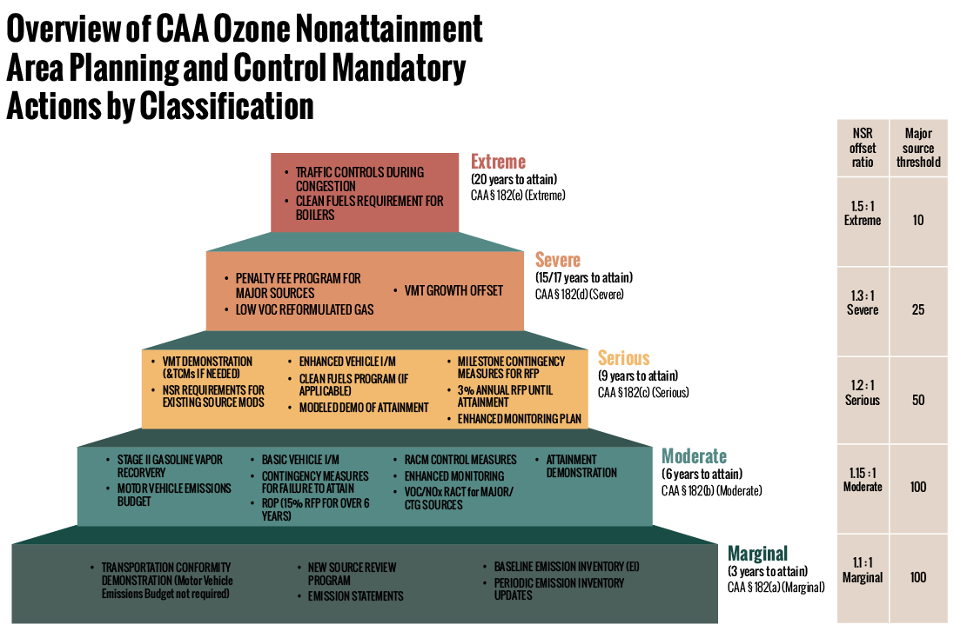

Slide 10
Ozone Overview
Overview of CAA Ozone Nonattainment Area Planning & Control Mandates by Classification
NSR offset ratio | Major source threshold
1.5 : 1 Extreme | 10
1.3 : 1 Severe | 25
1.2 : 1 Serious | 50
1.15 : 1 Moderate | 100
1.1 : 1 Marginal | 100
EXTREME
(20 years to attain)
TRAFFIC CONTROLS DURING CONGESTION
CLEAN FUELS REQUIREMENT FOR BOILERS
PENALTY FEE PROGRAM FOR MAJOR SOURCES
SEVERE
(15/17 years to attain)
LOW VOC REFORMULATED GAS
VMT GROWTH OFFSET
VMT DEMONSTRATION (& TCMs IF NEEDED)
NSR REQUIREMENTS FOR EXISTING SOURCE MODS
ENHANCED VEHICLE I/M
CLEAN FUELS PROGRAM (IF APPLICABLE)
SERIOUS
(9 years to attain)
MODELED DEMO OF ATTAINMENT
MILESTONE CONTINGENCY MEASURES FOR RFP
3% ANNUAL RFP UNTIL ATTAINMENT
ENHANCED MONITORING PLAN
STAGE II GASOLINE VAPOR RECOVRY
BASIC VEHICLE I/M
CONTINGENCY MEASURES FOR FAILURE TO ATTAIN
MODERATE
(6 years to attain)
ROP (15% RFP OVER 6 YEARS)
VOC/NOx RACT for MAJOR/CTG SOURCES
ATTAINMENT DEMONSTRATION
TRANSPORTATION CONFORMITY DEMONSTRATION
REFORMULATED GAS
MARGINAL
(3 years to attain)
NEW SOURCE REVIEW PROGRAM
MAJOR SOURCE EMISSION STATEMENTS
BASELINE EMISSION INVENTORY (EI)
PERIODIC EMISSION INVENTORY UPDATES

Slide 11
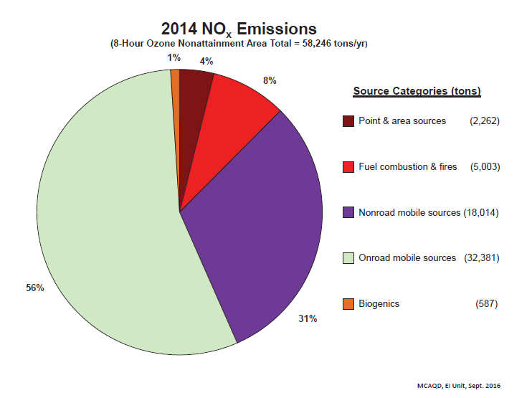
How Did We Get Here?
How did Maricopa County get to this point?
The majority of ozone pollution in Maricopa County is the result of vehicle exhaust (i.e. cars/trucks).
As much as 87% of the NOx emissions in 2014 were from vehicle engines.
All point sources together (e.g. power plants, landfills, fabricators) accounted for only about 4%.

Slide 12
Current Situation
Example:
Company A wants to move to Maricopa County and build a manufacturing facility which will emit 90 tons of NOx a year.
Company A will need to go through special permitting with the County, but will not be required to obtain “offsets.”
Company B wants to move to Maricopa County and build a manufacturing facility which will emit 100 tons of NOx a year.
Company B will need to go through special permitting and will be required to obtain offsets on the order of 115 tons. (100 tons x 1.15)
90 Tons
100 Tons
Permit
Permit
+
ERCs
Company A does not have to buy/create any ERCs.
Company B must buy/create 115% offset credits to build in County.
Results:
Results:

Slide 13
Current Situation – The “problem” is a lack of stationary sources from which ERCs can be created.
The ERC “bank” is virtually empty
Limited Places to get ERCs. ERCs are created when existing emission sources permanently reduce their emissions.²
Currently 14.14 tons NOx of which, only 7.14 tons are potentially “available.” ¹
Currently 266 tons VOCs of which, only 63 tons are potentially “available.” ¹
¹ ”Available” – a large company recently acquired the majority of these credits in anticipation of major expansion/new construction.

Slide 14
Market Summary
How does one get an ERC? ERCs are created when existing emission sources permanently reduce all or a portion of their emissions. The list of places to get an ERC is a very short list.
 | VOC | NOx | CO
3313 APS West Phoenix Power Plant | 17.9 | 441.5 | 81.5
43063 Arlington Valley LLC | 12.7 | 75.8 | 33.5
1218 Butterfield Station Facility | 5 | 16.7 | 25.3
127771 CMC Steel Fabricators Inc. | 25.5 | 42.7 | 561
44439 Gila River Power Station | 12.6 | 216.3 | 68.5
4173 Glendale Mun. Sanitary Landfill | 2.3 | 13 | 74.5
44186 Mesquite Power Operations LLC | 22.1 | 190.5 | 56.8
43530 New Harquahala Gen Co. | 4.5 | 38.8 | 28.1
20706 New Wincup Holdings Inc. | 156.5 | 11.4 | 2.6
1879 Northwest Regional Landfill | 48.5 | 21.1 | 96.4
1331 Oak Canyon Inc. | 100.6
52382 Ocotillo Power Plant | 4.5 | 76.4 | 13
42956 Redhawk Generating Facility | 6 | 153.5 | 156.8
303 Rexam Beverage Can Co. | 117.3 | 4.8 | 4.1
3315 Santan Generating Station | 7.9 | 211.8 | 100.5
4175 SFPP LP Phoenix Terminal | 114.2 | 3.6 | 8.2
3316 SRP Agua Fria Generating Stn. | 2 | 44.6 | 29.5
3317 SRP Kyrene Generating Station | 1.6 | 42 | 20.4
1210 Trendwood Inc. | 40.6
Totals: | 702.3 | 1604.5 | 1360.7
19 sources total
-10 are electric generating units
-3 are landfills
-2 are woodworking
-4 are miscellaneous
 | VOCs | NOx | CO
EGUs (10) | 91.8 | 1491.2 | 588.6
 | 13% | 93% | 43%
Landfills (3) | 55.8 | 50.8 | 196.2
 | 8% | 3% | 14%
Woodworking (2) | 141.2 | 0 | 0
 | 20% | 0 | 0
Miscellaneous (4) | 413.5 | 62.5 | 575.9
 | 59% | 4% | 42%
93% of NOx emissions come from the 10 EGUs. Very limited options for NOx offsets.

Slide 15
Has the lack of offsets impacted economic growth? - The “Lost 12”
According to GPAC, the following are 12 businesses with high potential emissions that ultimately chose not to locate in Phoenix. There are any number of reasons why they may have decided against Phoenix, but it is clear that without a liquid market for ERCs, moving to Maricopa County would be far more difficult for these and similar companies.
Project Alchemy - metal fabrication client looking for 50,000 SF of existing space
Project Kent - global leader in specialized steel production
Project Aspen - high tech manufacturing with use of chemical products and gases, large production plants, administrative offices, warehouse, supplier sites, and other uses
Project Fiberglass (Asked about non-attainment zones) - fiberglass manufacturing
Project Newfield (Asked about non-attainment zones) - new and significant, clean office, assembly and R&D facility
Project New World (Asked about non-attainment zones) – Car manufacturing
Project Buckshot (Still an active project looking at Casa Grande/Coolidge) – Plastic products
Project Sapphire 2 - Computer and Electronic Product Manufacturing
Project West (Asked about non-attainment zones) – Manufacturing client wasn’t able to disclose the type
Project Fiber - manufacturing pigment dispersions in reading devices
Project Diamond Star (Asked about non-attainment zones) - paper/tissue manufacturing facility
Project Cleopatra (Asked about non-attainment zones) - Transportation Equipment Manufacturing

Slide 16
Who can create ERCs?
Generally speaking, any operation that can show actual reductions in emissions by meeting the 5 EPA criteria – Real, Quantifiable, Surplus, Permanent, and Enforceable.
Existing individually permitted businesses are best for creating ERCs.
Operations that are currently in business, or even recently out of business.
Traditional ERCs
Non-Traditional ERCs

Slide 17
Without large “traditional” sources, where can one find offsets?
Non-Traditional Offsets
“Non-traditional offsets” are created by permanently eliminating or reducing emissions from non-stationary or non-major sources of NOx or VOC emissions.
Potential examples of non-traditional ERCs may include:
1) Railway switchyard electrification (e.g., switching locomotives)
2) Airport ground support equipment (e.g., electrifying support vehicles)
3) Electrifying garbage trucks or other “captive fleets” (i.e., those that don’t travel outside of Maricopa County)
4) Electrification of truck-stops, school buses, fork-lifts.

Slide 18
Market Summary - Alternatives
Obtaining ERCs from these non-traditional sources is not easy. In fact, the only example of a successful project was the Otay-Mesa project. A San Diego utility paid to retire an old ferry boat.
This is the only case of non-traditional offsets in Region 9 that we were able to find.

Slide 19
Issues With Non-Traditional Offsets
Three main issues with Non-Traditional Offsets:
1) Often require aggregation of multiple smaller emissions source reductions just to obtain a marketable amount.
2) Require substantial rule and state implementation plan development.
3) There is no real expertise in this area, so everyone is learning as they are doing.

Slide 20
Issues With Non-Traditional Offsets
Aggregation of multiple smaller emissions reductions:
To reach 115 tons of offsets, it is likely that a significant number of small, non-traditional sources would need to be aggregated.
As examples: To reach 115 tons of offsets, one would have to permanently retire the following numbers: ¹
= 29 diesel engines (1998-2003 model year). ²
= 96 diesel engines (2007-2009 model year).²
= 12,500 passenger cars ³
= 9,100 light trucks; or ³
= 11 diesel generators 74 hp each. ⁴
¹ These numbers are for illustration only. Specific engine details (model year, BHP, etc.) are needed before one can verify data.
² Source: CARB-NOx PM Calc.xls California Air Resources Board
³ Source: https://www.adeq.state.ar.us/air/planning/ozone/cars.aspx
⁴ Source https://www.in.gov/idem/ctap/files/engines_emissions_guidance.pdf

Slide 21
Five Criteria
Before emissions reductions can be converted to marketable offsets, the reductions must first meet five critical, regulatory elements:
1) Real - The emission reductions must be real.
2) Quantifiable - The amount, rate and characteristics of the emissions must be quantifiable.
3) Surplus - Emission reductions must be surplus at the time they are granted and the time they are used.
4) Permanent - Emission reductions must be permanent.
5) Enforceable – The permanence of the emission reductions must be enforceable.

Slide 22
ERC Valuation
ERC values for Texas and California (2 states with active ERC trading) are instructive when looking at pricing analysis.
California¹
Average price for all permanent ERCs, $33,000/ton (NOx)
Average price for all, including 1 yr ag, $21,957/ton (NOx)
High = $116,000/ton (NOx)
Low = $4,400/ton (NOx)
Texas ²
Average buy price for permanent ERCs, $70,388
Average sell price for permanent ERCs, $90,520
High = $245,000/ton (NOx)
Low = $30,000/ton (NOx)
¹ Emission Reduction Offset Transaction Costs Summary Report 2016, California Air Resources Board
² Emission Reduction Credit Trade Report, Texas 2016-2018

Slide 23
How to sell ERCs
Two ways traditional ERC acquisition has worked in the past.
First – a simple binary transaction. You create the ERC and sell it.
Second – equipment/process upgrades. ERC buyer pays for the installation and maintenance of the emissions control equipment or process upgrades. You get a more efficient, less emitting source, they get emission credits.

Slide 24
Conclusion
Ozone is a major problem for health and business.
ERCs reduce ozone, and offset requirements reduce it even more (15-20%).
This creates a great business model to monetize ERC potential.
If you have a permit (or had a permit) and can reduce your emissions, you may be able to get ERCs, which could mean $.

Slide 25
Michael Denby
Sr. Environmental Policy Advisor
Arizona Public Service Company
Michael.denby@aps.com
602-250-2870

